Slide 1
Chapter 0: Introduction
A First Course in Network Science

Slide 2
Course description
Networks pervade all aspects of our lives: networks of friends, communication, computers, the Web, and transportation are examples we experience, while our brain cells and the proteins in our body form networks that determine our survival and intelligence.
The network is a general yet powerful way to represent and study simple and complex relationships. This course explores the study of networks and how they help us understand the complex patterns of connections and relationships that shape our lives.
Through examples from popular social and information networks, students learn about key aspects of networks and basic tools to analyze and visualize them.

Slide 3
Course objectives
Learn essential concepts and core ideas of network literacy
Acquire skills to load, manipulate, export, visualize networks using tools and programming languages such as Python/NetworkX, NetLogo, and Gephi
Recognize and describe a network's structural components and properties (nodes, links, degree, connectivity, sparsity, paths, etc.)
Analyze social networks and inspect their small-world properties
Measure various centrality measures and their distributions, and apply them to detect important nodes and characterize their roles in the network
Understand the friendship paradox, according to which your friends have more friends than you do, on average
Quantify network homophily and clustering and explain how they arise in different systems
Describe dynamic processes on networks, such as the spread of diseases and rumors
Demonstrate the networks algorithms used by search engines to crawl and rank Web pages
Appreciate the broad relevance of network science to domains and applications such as biology, business, AI, search, recommendation, social media

Slide 4
Software
We will be using Python and the NetworkX (networkx.readthedocs.org) module. You can follow one or both of two approaches:
There are currently several free services to run Jupyter notebooks in the cloud, including:
Google Colab (colab.research.google.com)
Binder (mybinder.org)
Kaggle Kernels (www.kaggle.com/kernels)
Azure Notebooks (notebooks.azure.com)
Datalore (datalore.io)
Gryd (gryd.us)
If you wish to run Python locally on your laptop, and don't have Jupyter/IPython installed on your machine, we recommend installing the Anaconda Python 3 distribution (www.anaconda.com/distribution). We do not recommend other distributions. This option requires that you are comfortable with managing software packages (i.e., using `pip` or `conda`).
Be warned: each cloud-based notebook service has pros and cons and we cannot test them all extensively, so your mileage may vary. You may have to try more than one solution, read documentation, and/or seek support from the providers to install packages. Local Python installations can present issues, especially on Windows machines. Packages are system dependent. Instructors may be unable to provide support.

Slide 5
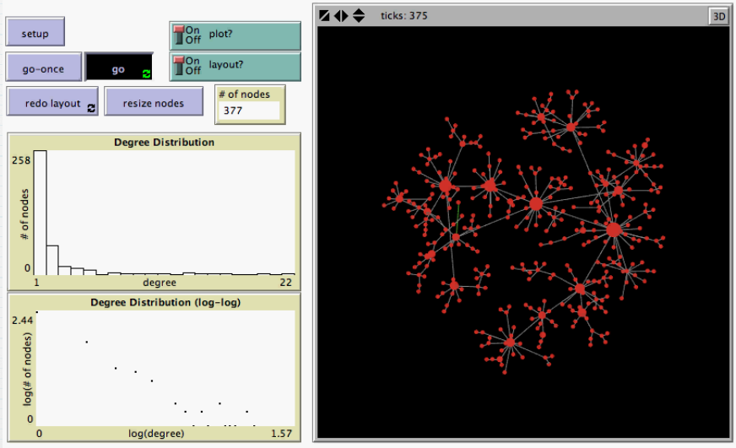
Other software
Gephi (gephi.org)
NetLogo (ccl.northwestern.edu/netlogo)

Slide 6
Network gallery

Slide 7
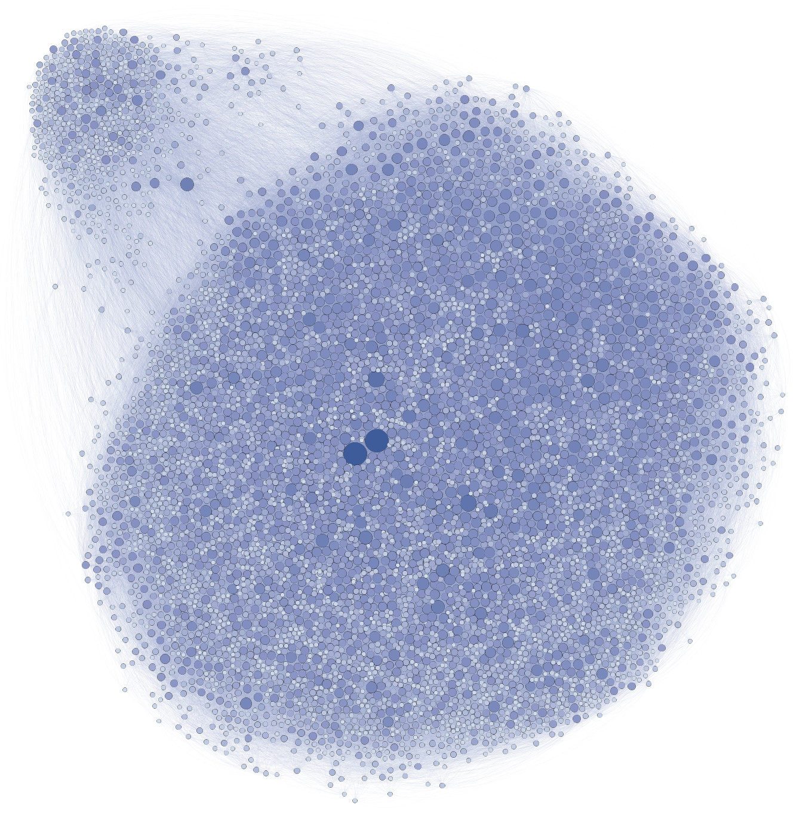
Facebook users at Northwestern University
What do nodes represent?
What do links represent?
Do links have direction?
Do links have weights?
Larger, darker nodes have more connections; what does that represent?
What do the two clusters tell us?

Slide 8
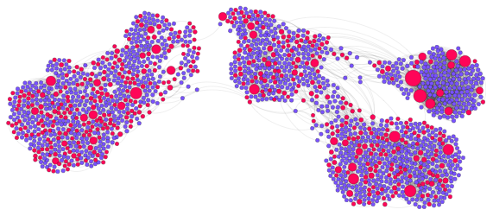
Movie-star network based on a small sample from IMDB
Blue nodes represent movies
Red nodes represent actors/actresses
What do links represent?
Do links have direction?
Do links have weights?
Larger nodes have more connections; what does that mean?
What do the clusters represent?

Slide 9
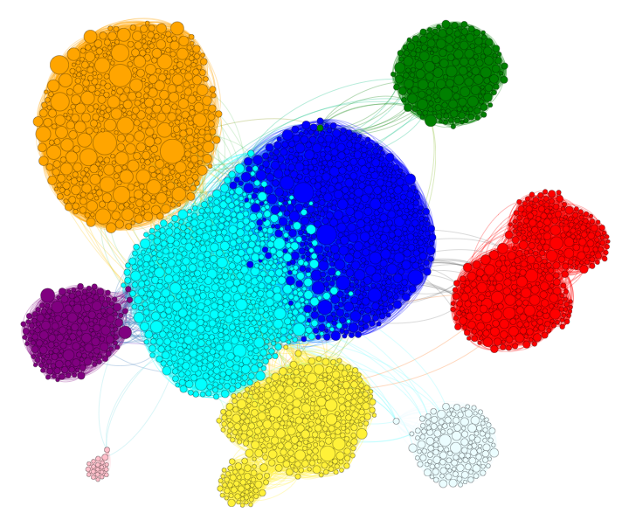
Movie co-star network based on a small sample from IMDB
What do nodes represent?
What do links represent?
Do links have direction?
Do links have weights?
Larger nodes have more connections; what does that mean?
What do the clusters represent?

Slide 10
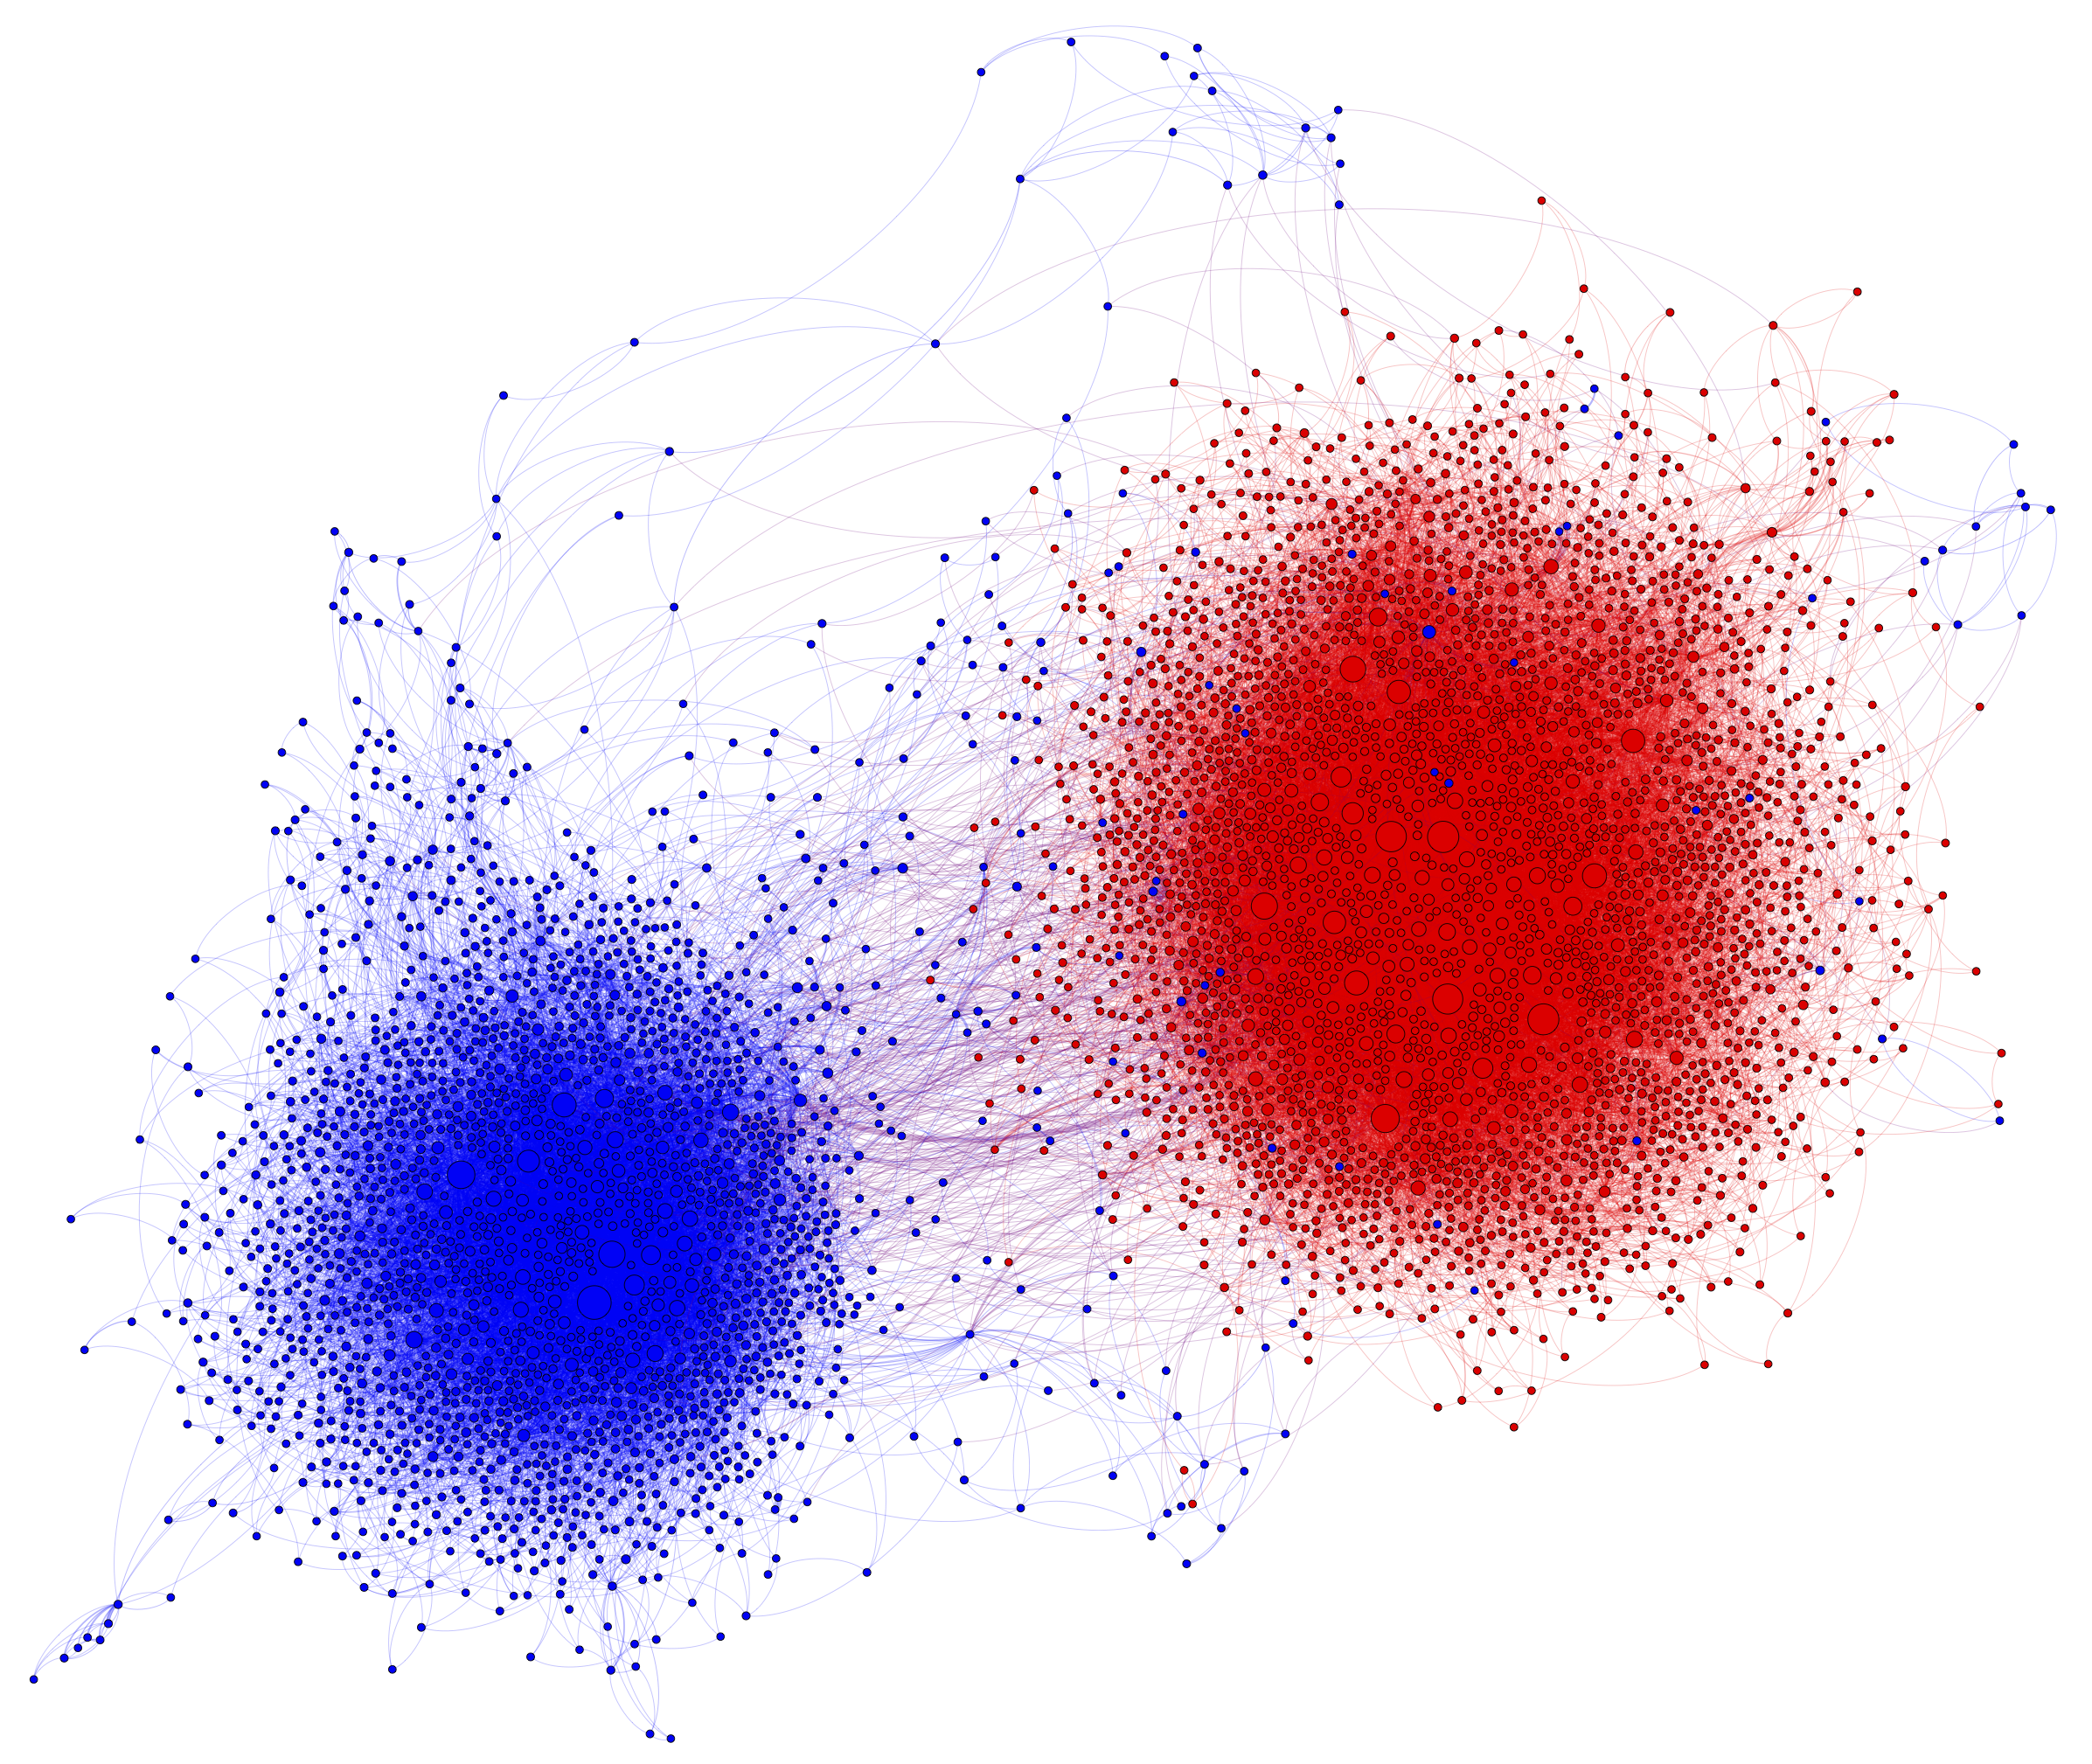
Retweet network on Twitter, based on political posts during 2010 US election
What do nodes represent?
What do links represent?
Do links have direction?
Do links have weights?
Larger nodes have more connections; what does that mean?
What do the clusters and colors represent?

Slide 11
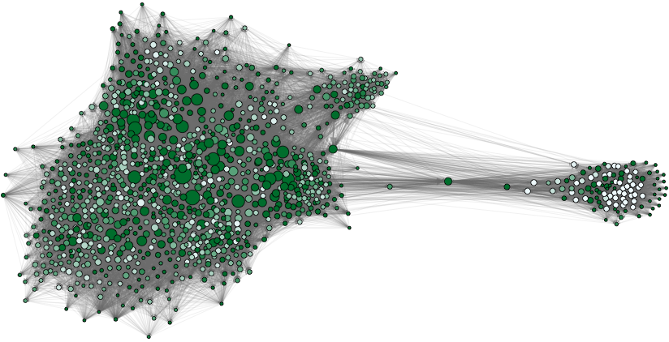
Email network based on a sample of Enron emails
What do nodes represent?
Node size/color represent number of incoming/outgoing links; what do you notice?
What do links represent?
Do links have direction?
Do links have weights?
What do the clusters represent?

Slide 12
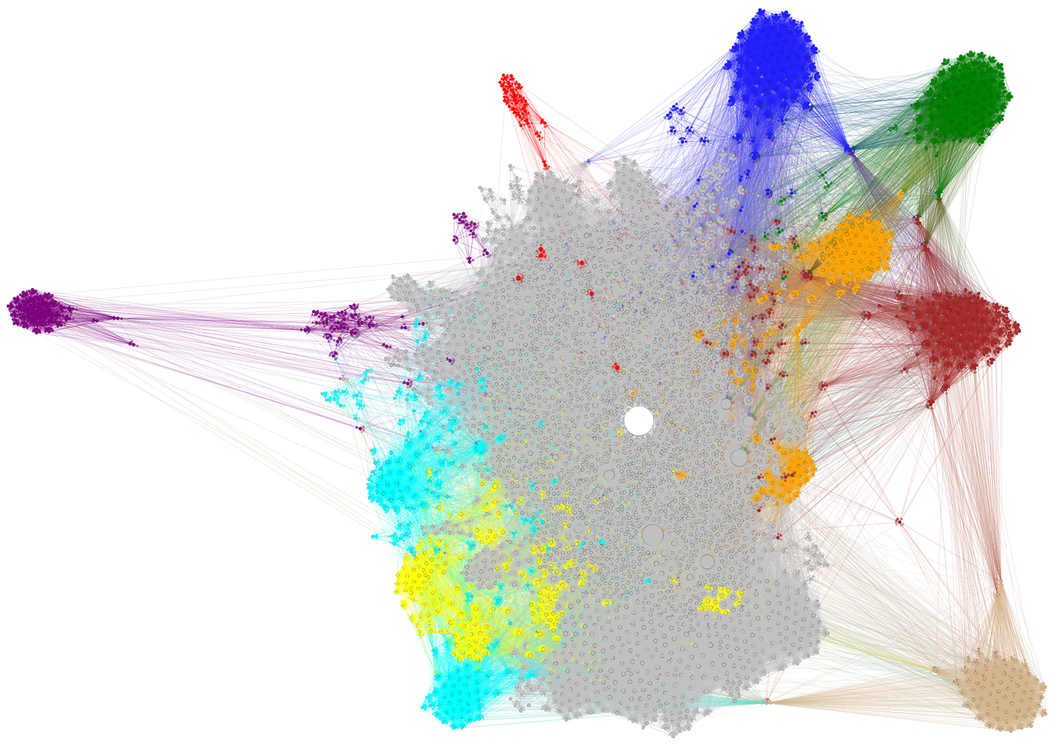
Math information network on Wikipedia
What do nodes represent?
What do links represent?
Do links have direction?
Do links have weights?
Larger nodes are more "important"; how would you measure importance?
Can you guess what is the large white node?
What might the colored clusters represent?

Slide 13
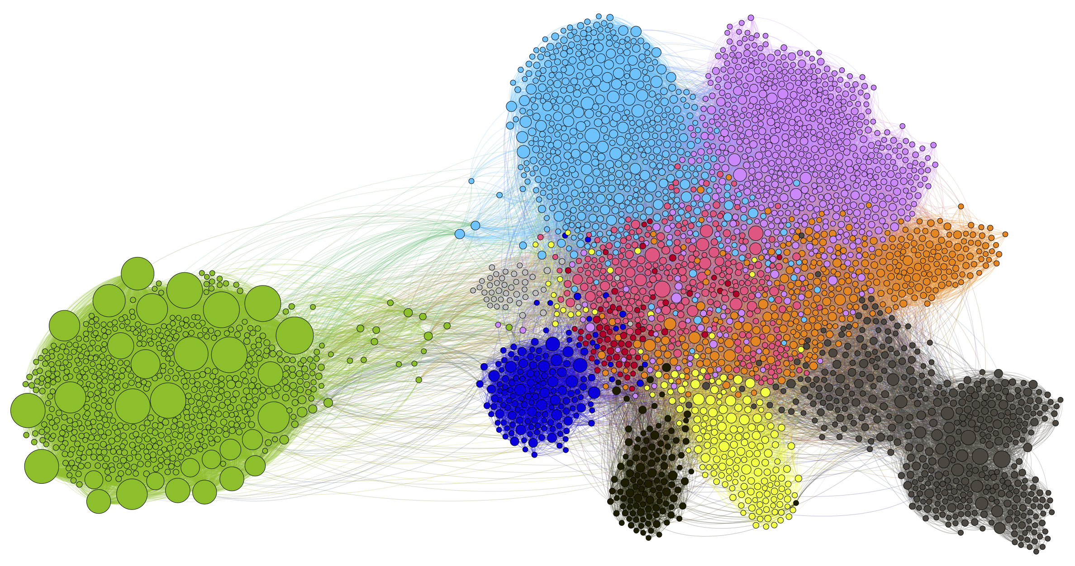
A portion of the Internet router network
What do nodes represent?
What do links represent?
Do links have direction?
Do links have weights?
Larger nodes have more connections; what does that mean?
What might the colored clusters represent?

Slide 14
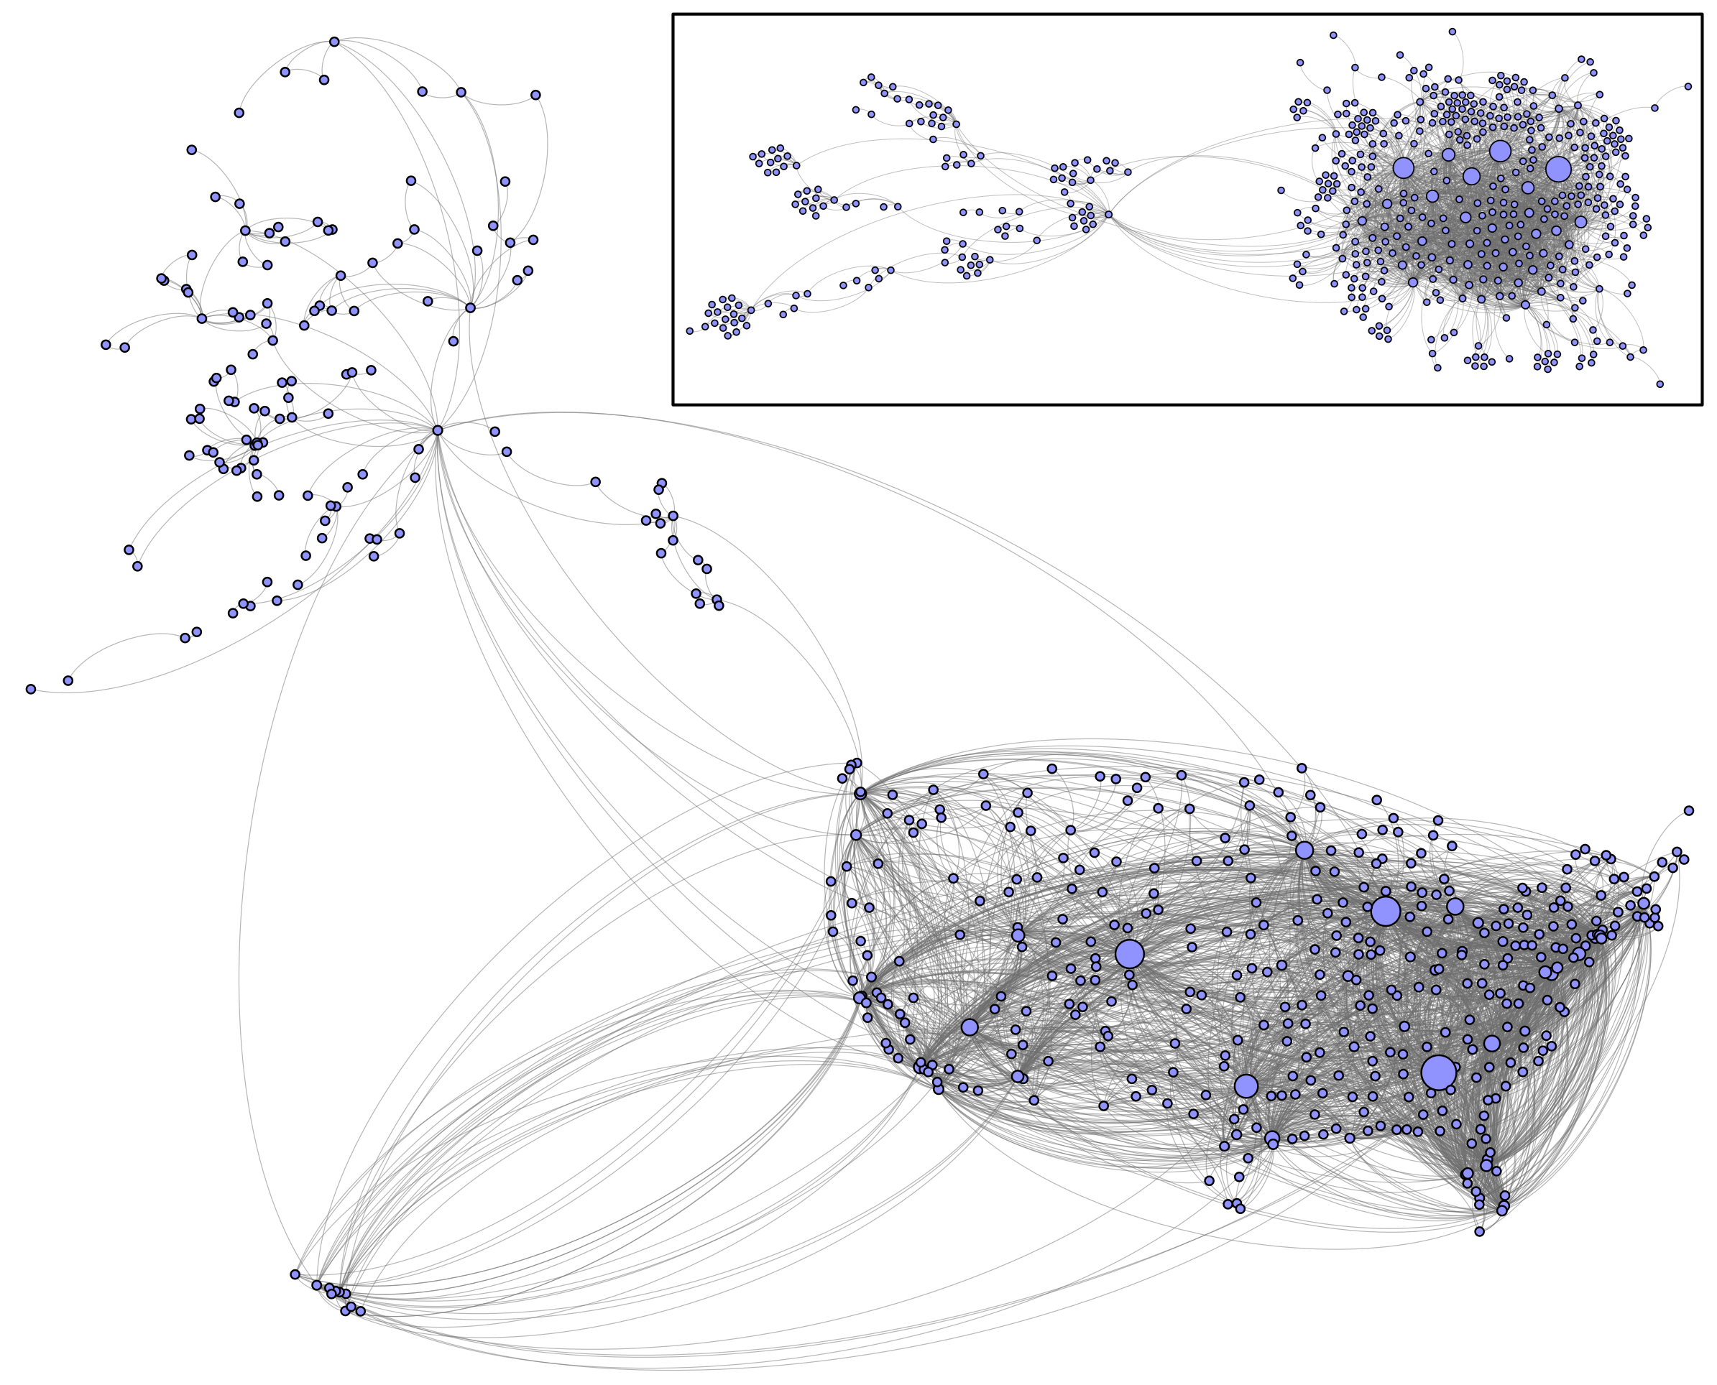
US air transportation network
What do nodes represent?
What do links represent?
Do links have direction?
Do links have weights?
Larger nodes have more connections; what do they represent?
What do the layouts represent?

Slide 15
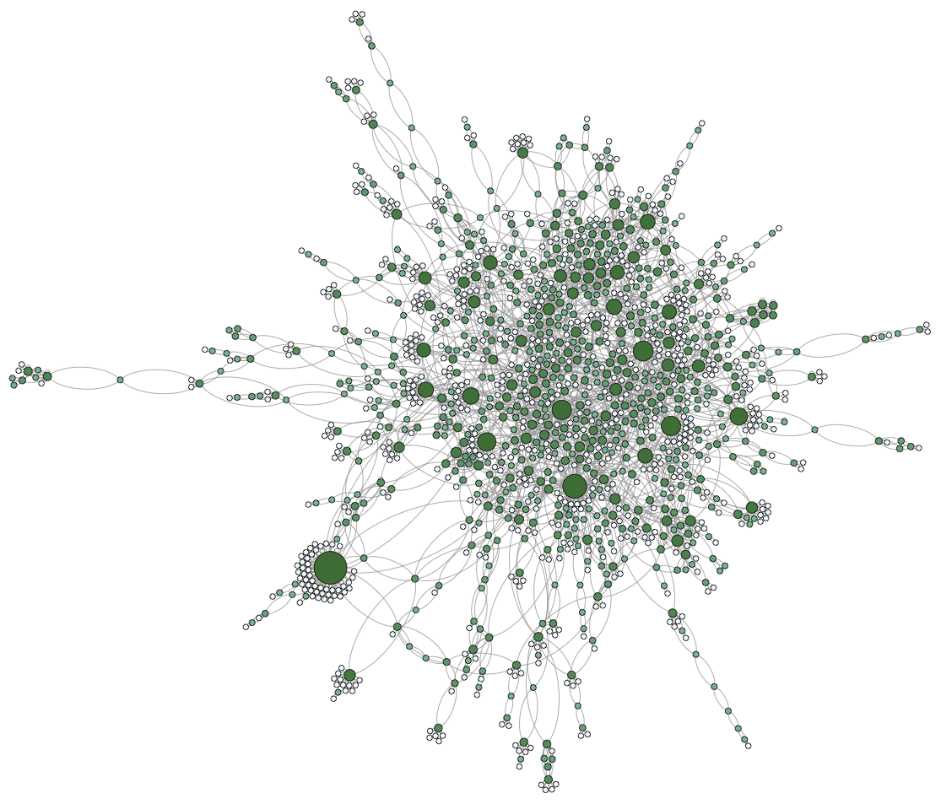
Protein interaction network of yeast
What do nodes represent?
What do links represent?
Do links have direction?
Do links have weights?
Larger nodes have more connections; what does that mean?
What do the clusters represent?

Slide 16
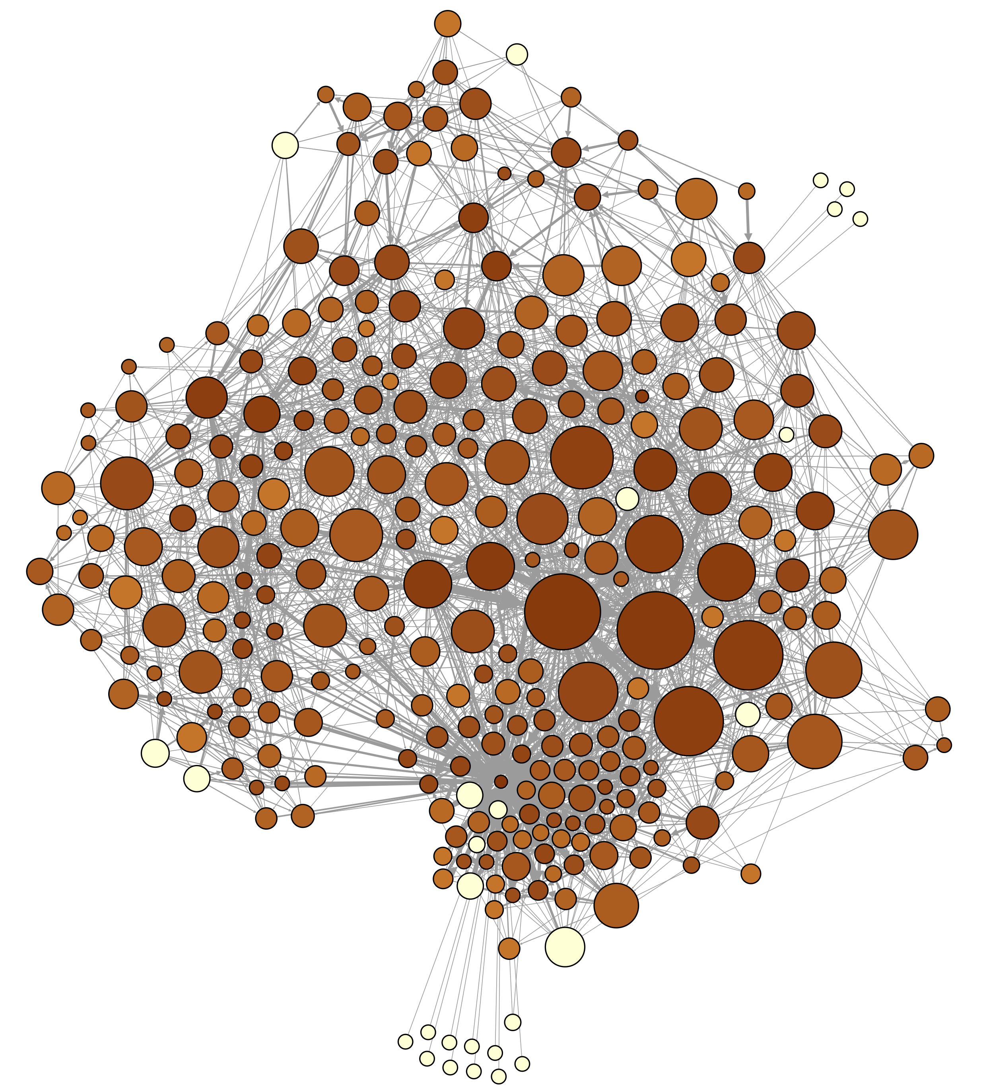
Neural network of the roundworm c. elegans
What do nodes represent?
What do links represent?
Do links have direction?
Do links have weights?
Larger/darker nodes have more outgoing/incoming connections; what does that mean?

Slide 17
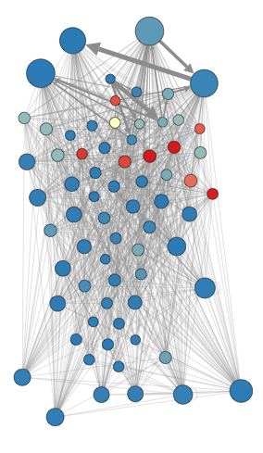
Food web of species in the Florida Everglades
What do nodes represent?
What do links represent?
Do links have direction? What does it represent?
Do links have weights? What do they represent?
Larger nodes have more incoming links; what are they?
Red nodes have more outgoing links; what are they?

Slide 18
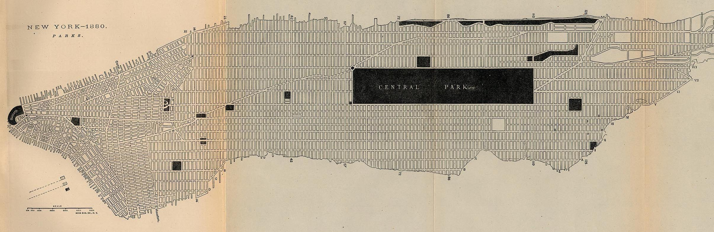
What are the nodes and links of the network represented in this street map?
Map of New York in 1880. From Report on the Social Statistics of Cities, Compiled by George E. Waring, Jr., United States Census Office, 1886. Image courtesy of University of Texas Libraries

